Slide 1
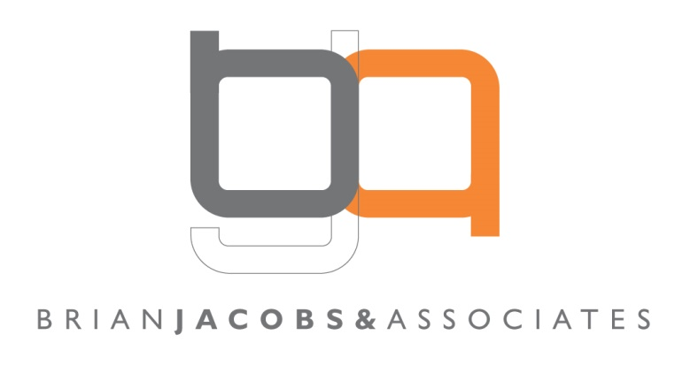

Spending Advertising Money?
APAN 2016 Annual Conference
14th January, Lisbon
Brian Jacobs - BJ&A Ltd
Efficient communications

Slide 2

Lessons from 1895; 1947; 1984 and 2015
Introduction
The more things change..
A few facts
Navigating the media world

Slide 3
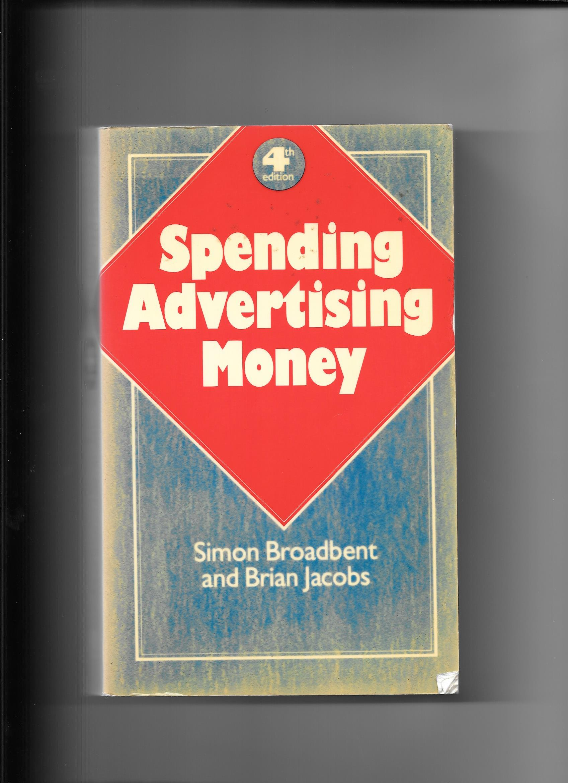

Slide 4
?

Slide 5
The Word ‘Advertising’ Can Be Restrictive
In a digital world, inventory is unlimited
User generated content is everywhere
Adblockers exist
Online media consumption habits differ from offline
The line between ‘editorial’ and ‘advertising’ has become increasingly blurred
Brands can become channels and create content
How can brands best reach and influence their (prospective) customers?

Slide 6
Advertisers need to use all appropriate media forms and techniques to achieve their goals.
The successful will base their approach on the facts and will blend the old and the new.

Slide 7
The More Things Change…
The agency’s key task remains as it has always been: to place the right messages in front of the right people in the right place at the right time and at the right price to make a difference to the client’s business.
It’s just that now there are many more opportunities to get it wrong, and more definitions of ‘right’.

Slide 8
The More Things Change…
No-one doubts that the media world has undergone fundamental and irreversible change
BUT
TV didn’t kill radio
Cinema didn’t kill TV
Videos didn’t kill cinema
Media forms evolve and co-exist; they very rarely kill each other
Press headlines can be misleading

Slide 9
The More Things Change…
Advertising is not ‘dead’
TV is not ‘dead’
Very few people want to ‘have a conversation with your brand’ (FB = c. 7 in 10,000; Twitter = c. 3 in 10,000)
Multi-channel messages still work better than single-channel
The best advertisers will still experiment and learn

Slide 10
Use of online media forms is growing, as is the amount invested.
Digital advertising accounted for 23.6% of total adspend in 2015, up around 14% year-on year.
Digital advertising accounted for 9.0% in 2007.
Source: GroupM TYNY
The next chart comes from Mary Meeker’s (KPCB) annual presentation on trends in internet usage: kpcb.com/internetTrends

Slide 11
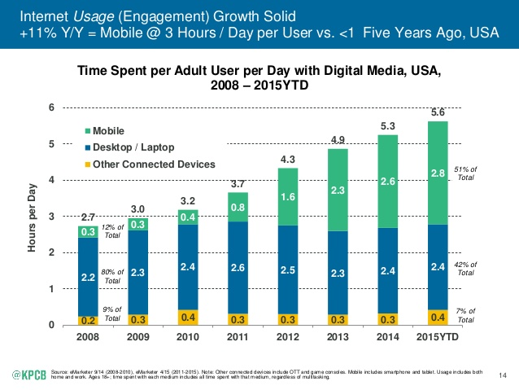

Slide 12
Not Everything in Digital Media is Wonderful
‘The Financial Times’ recently ran an experiment buying their own inventory. 18% finished up in the actual FT
‘62% of all online traffic is seen only by bots’. Wall Street Journal
‘54% of paid-for display ads never ran where they were supposed to run’. Wall Street Journal
‘The current standards on viewability (50% for 1 second) are ‘ludicrous’. Sir Martin Sorrell, DMEXCO, September 2015
Approximately 30% - 40% use adblockers

Slide 13
Lots of people are still watching TV (on various devices)
Not so many are avoiding the ads
Most winners in advertising effectiveness competitions still have TV at their heart
The next few charts are from Thinkbox, the UK TV industry’s marketing body. www.thinkbox.tv

Slide 14
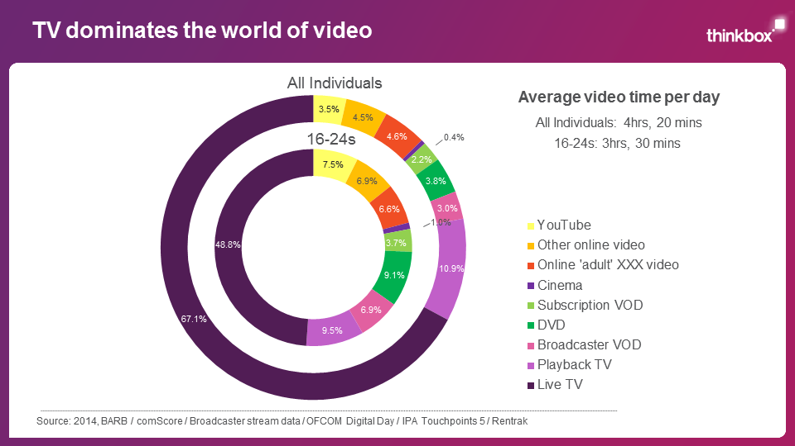
What We Did

Slide 15
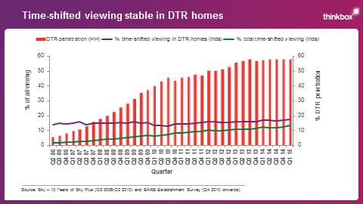

Slide 16
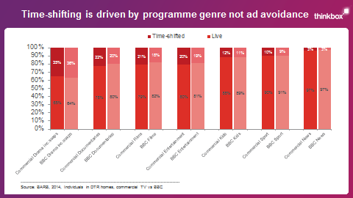

Slide 17
The Implications of Change for Advertisers
Most advertisers are not resourced to be able to keep up with the pace of change within media
Agencies have expanded their service offerings by investing in various technology businesses
This can put some agencies in the (un)enviable position of being both buyer and seller
Advertisers need to be confident that they are getting the best, objective advice from their partners

Slide 18
One current trend is the growth in programmatic advertising. What is it?

Slide 19
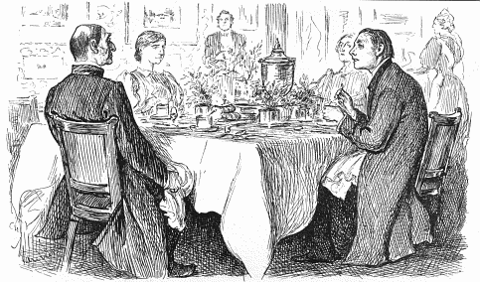
Bishop: “I'm afraid you've got a bad egg, Mr Jones” Curate: “Oh, no, my Lord, I assure you that parts of it are excellent!” ‘Punch’ November 1895

Slide 20
Programmatic – the Curate’s Egg of the Media World
‘Programmatic’ is not a channel but a technique
The technique can bring the benefits of automation to many elements of the process of placing ads
It can also bring the benefit of making large quantities of data available and accessible to the planner
Some applications of programmatic (like real time bidding or RTB) can lead to a loss of control over where your ads appear
Programmatic direct can combine benefits and control

Slide 21
Agencies will often propose the latest fad or trend in media usage, regardless.
Their proposals should be tempered by internal and external lessons learned.
The next few charts attempt to summarise some learnings from one source.

Slide 22
Learning from the Facts – Peter Field and Les Binet
Peter Field and Les Binet have mined over 1,000 IPA case studies, from UK and overseas for their book ‘The Long and the Short of It’
They have examined advertising effect over time and its relationship with profit
Their cases go back over 30 years, with the majority coming from the last 10 (digital) years

Slide 23
Learning from the Facts – Peter Field and Les Binet
Is the growth in data availability fooling us?
Different time frames lead to different strategies and different effects
Long-term effects = profitable brands
‘You can’t build long-term effects by piling short-term effects on top of one another’ (Peter Drucker)
Focusing only on the short-term jeopardises the long-term
Targeting existing customers does not create long-term brand growth

Slide 24
Learning from the Facts – Peter Field and Les Binet
To create activations short-term you need to appeal to the rational
Real-time evaluations can steer you away from long-term profit
Creative ads (award winners) are strongly correlated with profitable brands
As a crude generalisation, long-term brand building should be c.60% of the effort; short-term activation c.40%

Slide 25
Navigating the Media World
Always question your agency’s media recommendations; in the same way that you would a creative recommendation
Does the plan take account of your previous experiences?
Is the plan fully justified and explained?
Does every element of the plan make sense to you?
Do you have the right creative for the media selected (TV and online video are not viewed in the same way)?
Is the pricing fully explained and justified?
Does the pricing make sense to you?
If in doubt seek external expertise

Slide 26
In Summary
The best media plans blend experience with the new reality
Always challenge; always ask questions
It’s your money; make sure you’re comfortable with how the agency is spending it

Slide 27
A Final Word from History
“I don’t want academicians. I don’t want scientists. I don’t want people who do the right things. I want people who do inspiring things.
..(Too many people) are up on advertising technique. They could defend every ad on the basis that it obeyed the rules of advertising. It’s (as if) they (were) worshipping a ritual instead of the God.
Let us prove to the world that good taste, good art and good writing can be good selling.”
Bill Bernbach, May 15th 1947

Slide 28
Spending Advertising Money?
APAN 2016 Annual Conference
14th January, Lisbon
Brian Jacobs - BJ&A Ltd
Efficient communications

