Slide 1





Slide 2
ORDER OF SERVICE
What’s going wrong?
What do you think?
7 deadly sins and rethinking.

Slide 3


Slide 4
WHAT’S GOING WRONG?

Slide 5
80% of brands believe they deliver great consumer experiences (Cibo, 2014)
Only 8% of consumers agree

Slide 6
The majority of people worldwide wouldn’t care if 73% of brands disappeared tomorrow (Havas Meaningful Brands)

Slide 7
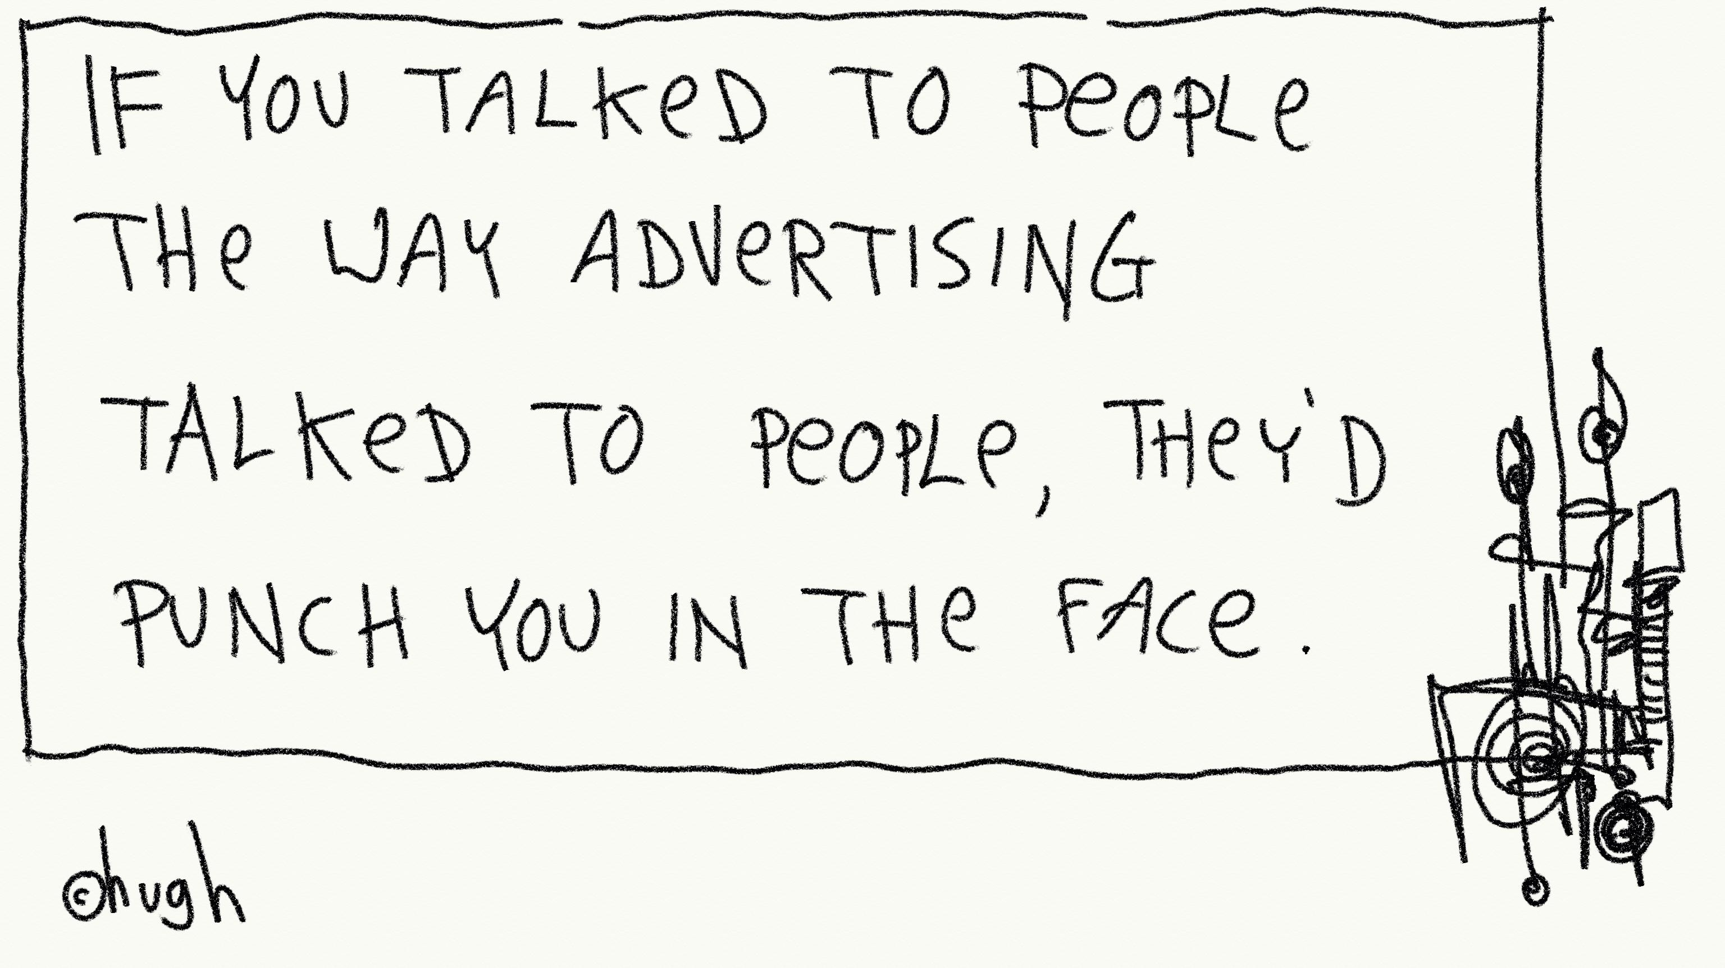

Slide 8
To develop a better understanding of what people want and expect from brands so WFA can help marketers better align marketing strategies and practices with people’s changing expectations and sensitivities.
PROJECT RECONNECT OBJECTIVE:

Slide 9
“In the Digital Age, every brand can have it’s own Wikileak moment…never been a ‘better’ or ‘tougher’ time to be in marketing.”
MARTIN RILEY, Pernod Ricard
“Brands are only as strong as their weakest link.”

Slide 10
“Brands too need to let others in. Just as we let our friends into the inner working of our lives, asking for advice and help, we can let people and partners keep us relevant. Together, with them, we can pioneer the future of marketing and create shared value strategies that benefit a world beyond the brand alone.”
MARC MATHIEU, Samsung
“Fundamentally, the future of all our brands. If we, as brands, behave as we aspire to behave as people – truthful, generous, caring, fun and supportive – immeasurably stronger.”

Slide 11
WHAT’S GOING WRONG?
WHERE TO START…

Slide 12
THERE’S THIS!

Slide 13


Slide 14
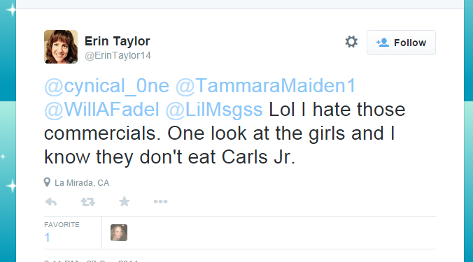

Slide 15
THERE’S THIS!

Slide 16
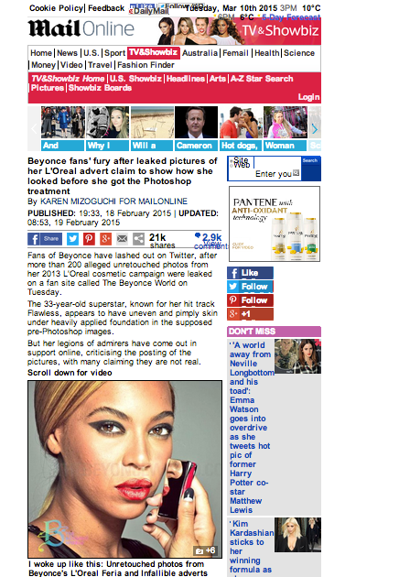

Slide 17
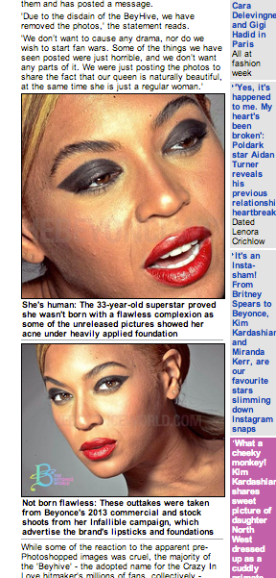
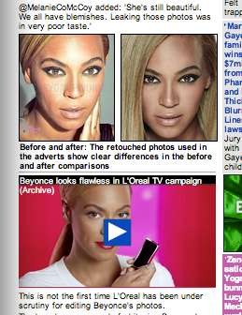

Slide 18


Slide 19
THERE’S THIS!

Slide 20


Slide 21
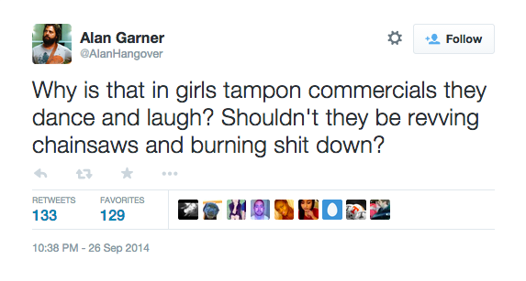

Slide 22
…AND THIS!

Slide 23
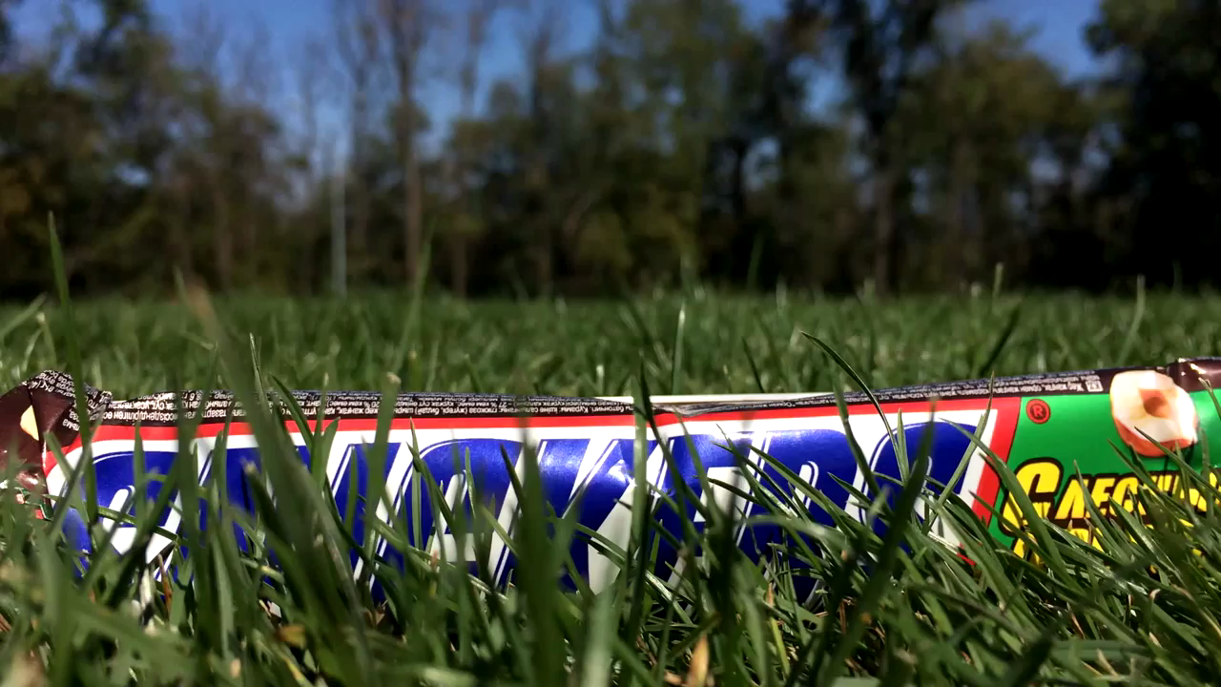

Slide 24
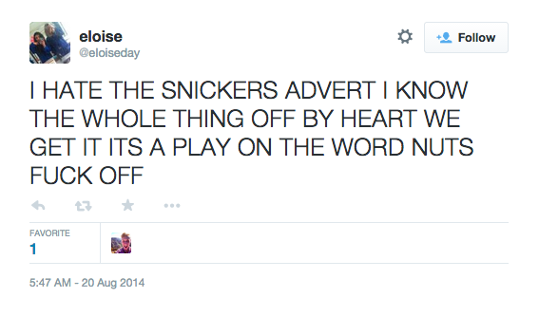

Slide 25
SO IT’S INSULTING
….UNREALISTIC
….ANNOYING
…INTERRUPTIVE
….REPETITIVE

Slide 26
WHAT DO YOU THINK?

Slide 27

Of 5 million tweets:
2 million negative tweets
Each person over 1,000 followers
“Real people, real conversations” – the public majority
What can we learn?

Slide 28

SEVEN
DEADLY SINS

Slide 29
SIN 1:
OUT OF FAVOUR!

Slide 30
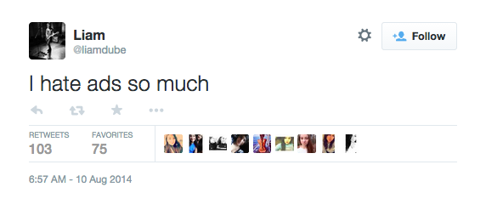

Slide 31
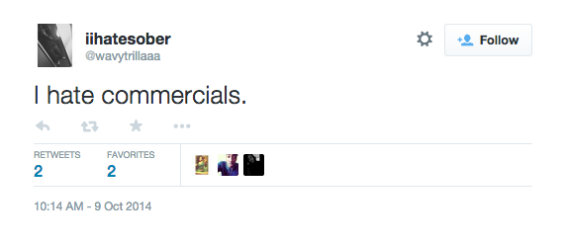
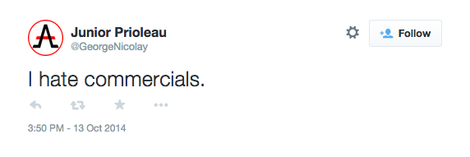
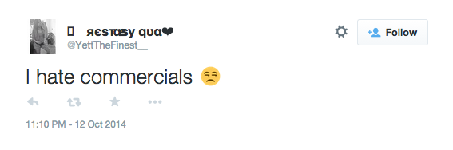
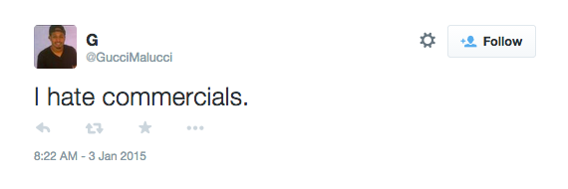
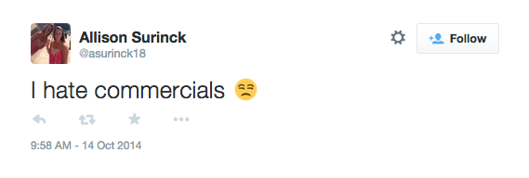
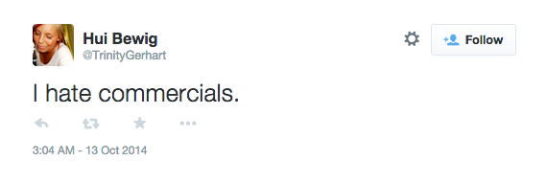
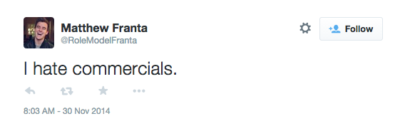
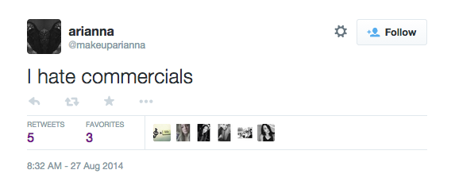
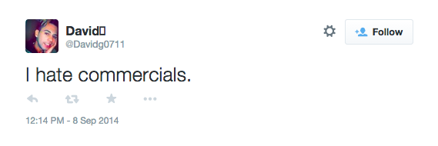
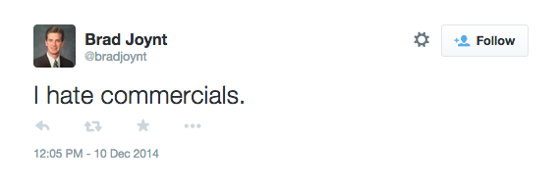
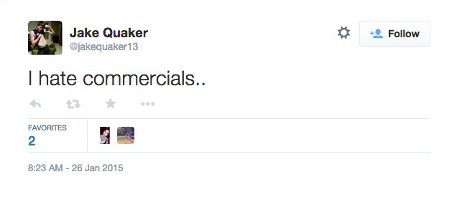
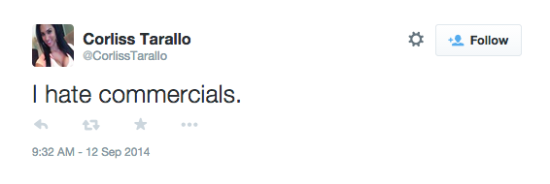
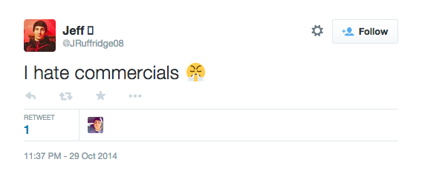
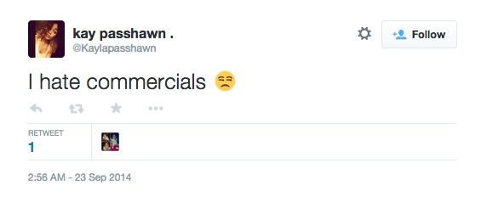
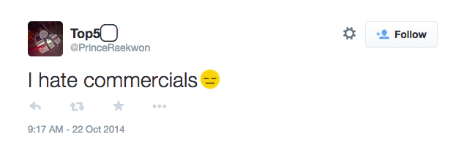

Slide 32
RETHINK
A changing world requires different rules of engagement.
Entertaining or useful?
Neither? Forget it.

Slide 33
SIN 2:
STOP
INTERRUPTING ME!

Slide 34
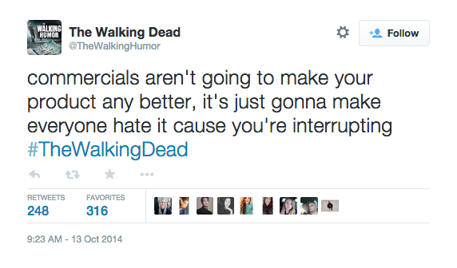

Slide 35
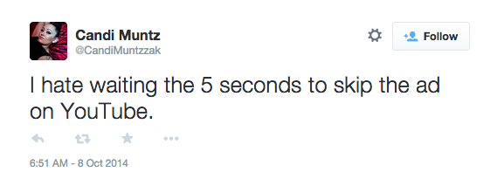

Slide 36
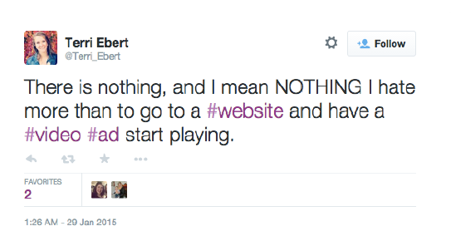

Slide 37
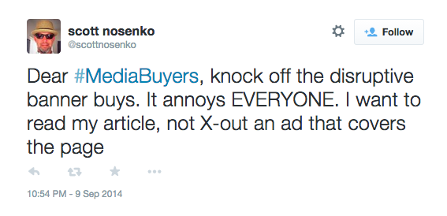

Slide 38


Slide 39
RETHINK
With proximity comes respect.
New platforms, old money thinking.
The closer you get the more self awareness you need.

Slide 40
3. CHOOSE YOUR MOMENTS
SIN 3:
CHOOSE YOUR MOMENTS

Slide 41
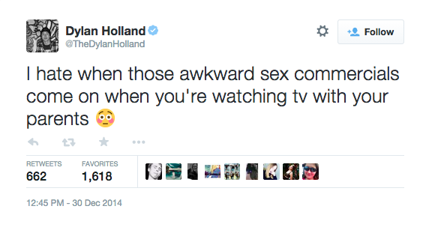

Slide 42
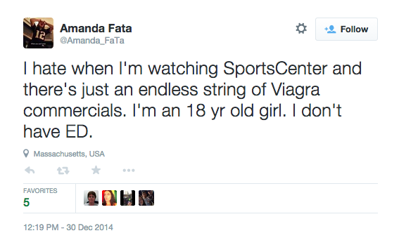

Slide 43
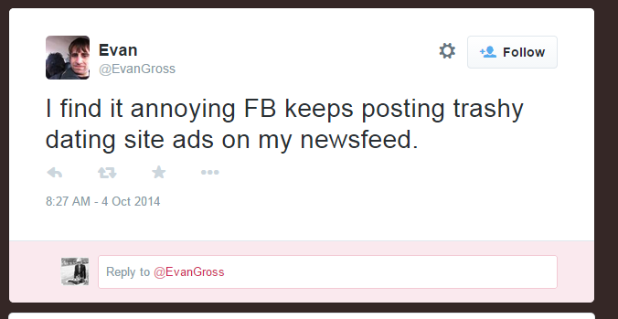

Slide 44
RETHINK
Right time, wrong place.
Right time, wrong audience.
Perils of retargeting.

Slide 45
SIN 4:
THE TRUTH WILL SET YOU FREE

Slide 46
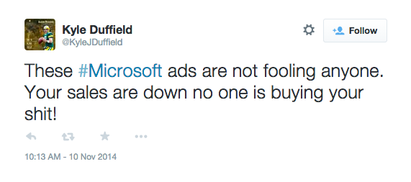

Slide 47
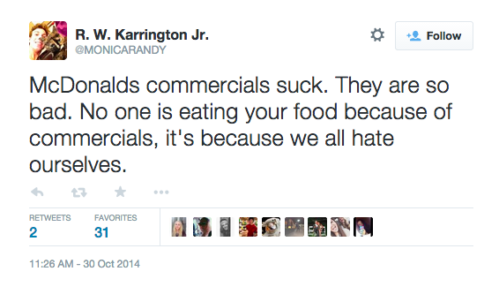
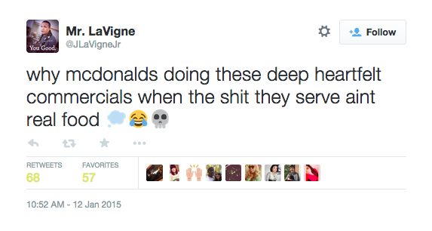

Slide 48
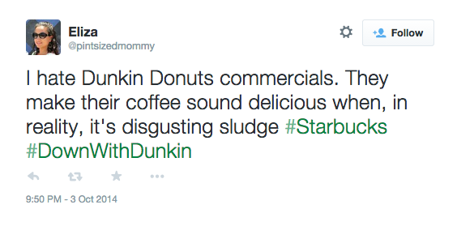

Slide 49
RETHINK
The job of advertising is not to fill the reality gap.
Be honest, gain respect.
Be real, don’t airbrush.

Slide 50
5. IT’S ALL TOO MUCH
SIN 5:
IT’S ALL TOO MUCH

Slide 51
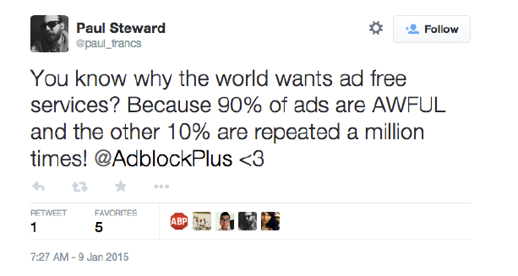

Slide 52
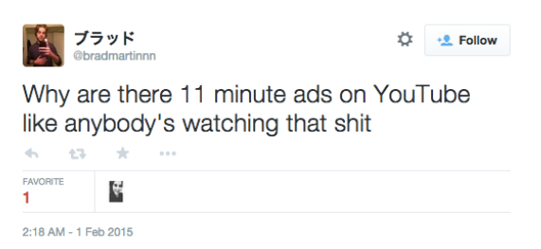

Slide 53
RETHINK
Too much, frequency caps?
Significant need for regulation – self & other.
Being remembered doesn’t correlate with being liked.

Slide 54
SIN 6:
THIS TIME IT’S PERSONAL

Slide 55
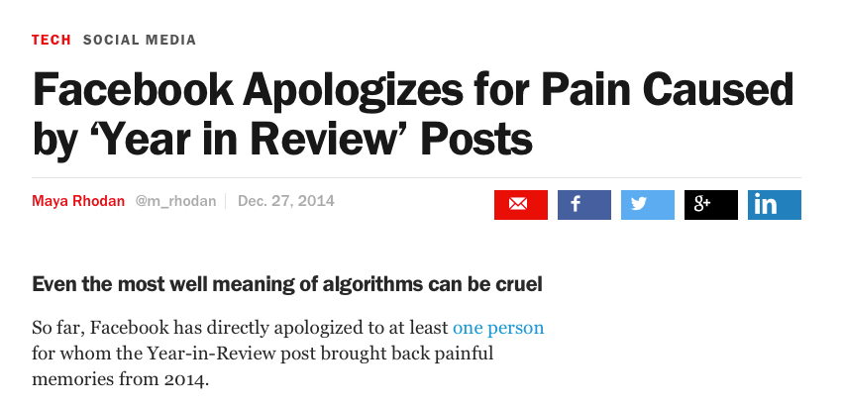

Slide 56
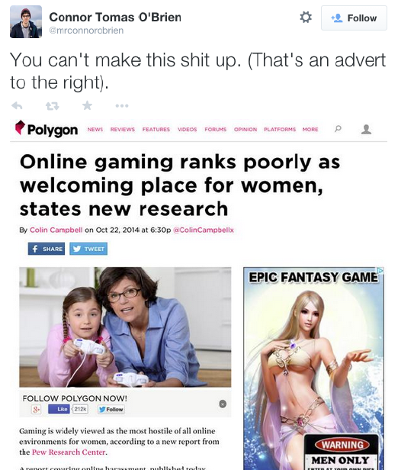

Slide 57
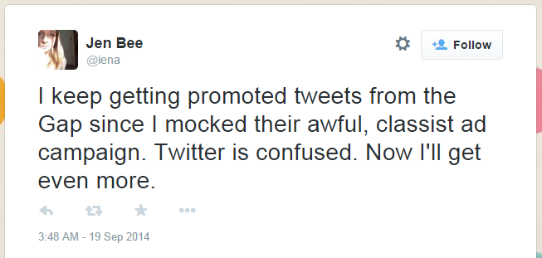

Slide 58
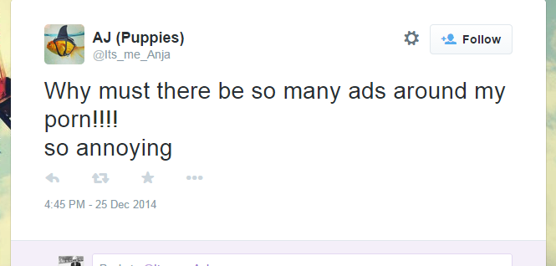

Slide 59


Slide 60
RETHINK
Programmatic problems.
Behavioural models need inspection.
Privacy/blocking will reach epidemic proportions without regulated behaviour.

Slide 61
SIN 7:
IT’S JUST NOT GOOD ENOUGH

Slide 62
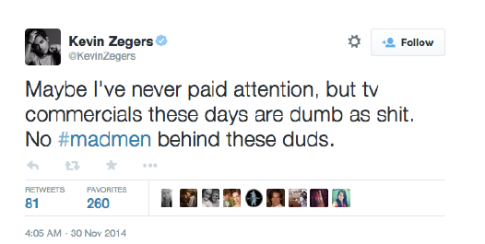

Slide 63
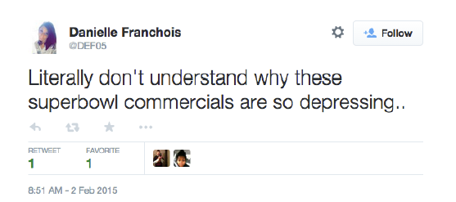
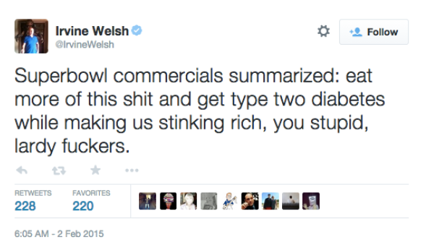

Slide 64

POWER OF POSITIVE ACTION

Slide 65


Slide 66
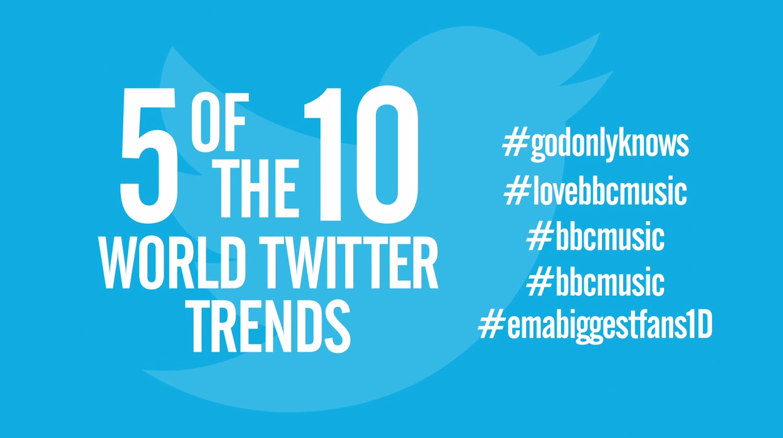

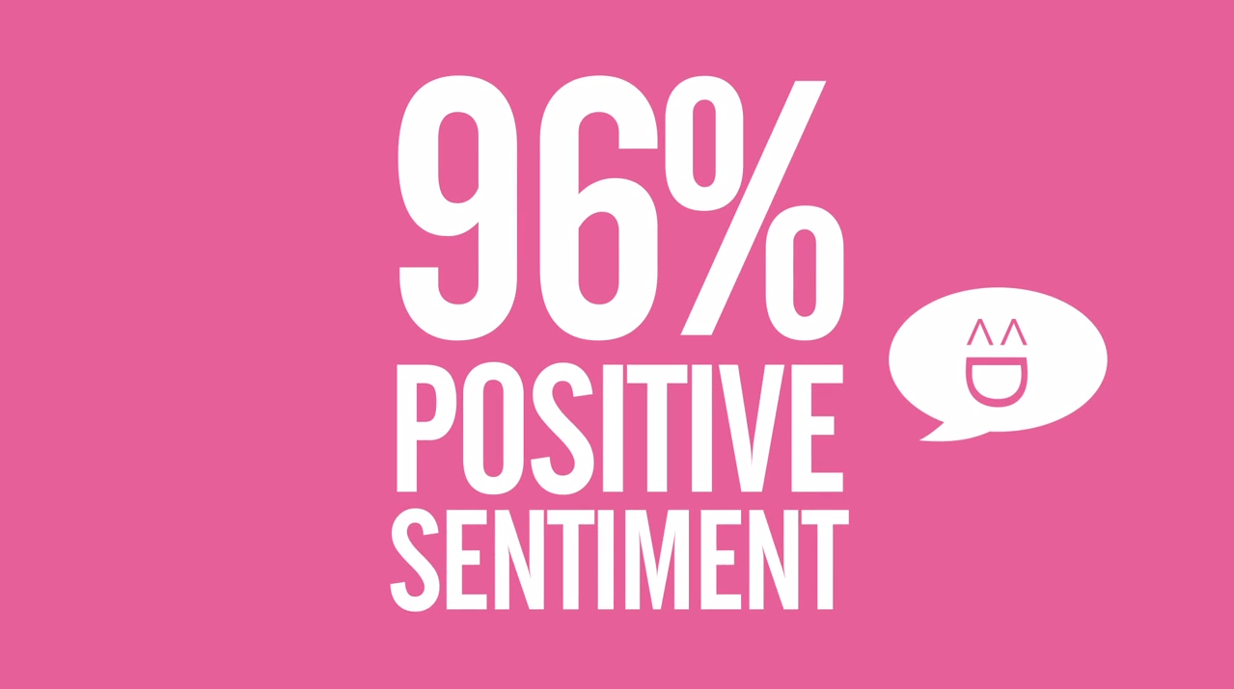
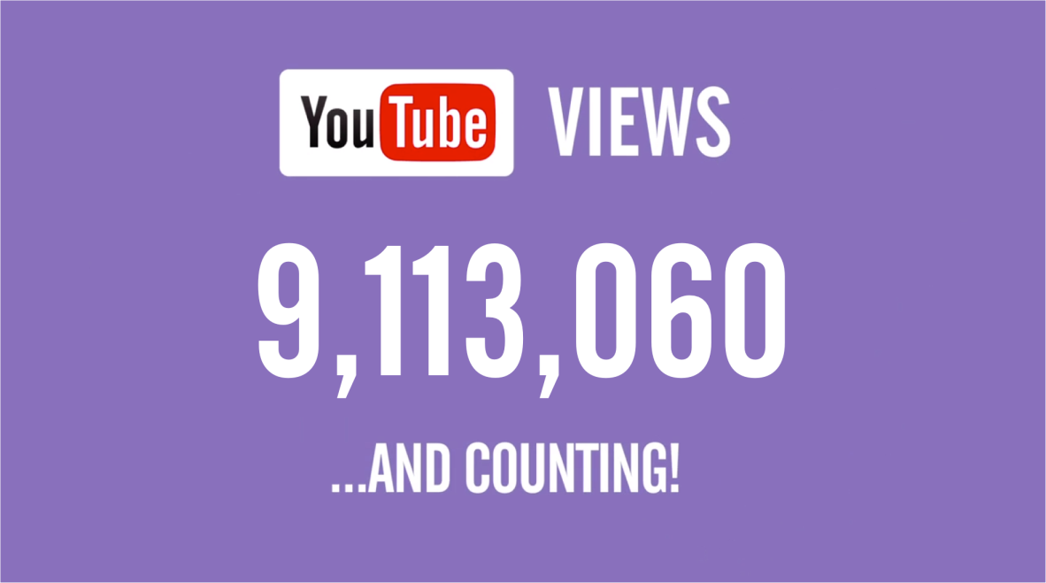
1 BILLION
GLOBAL REACH
21,975,712

Slide 67
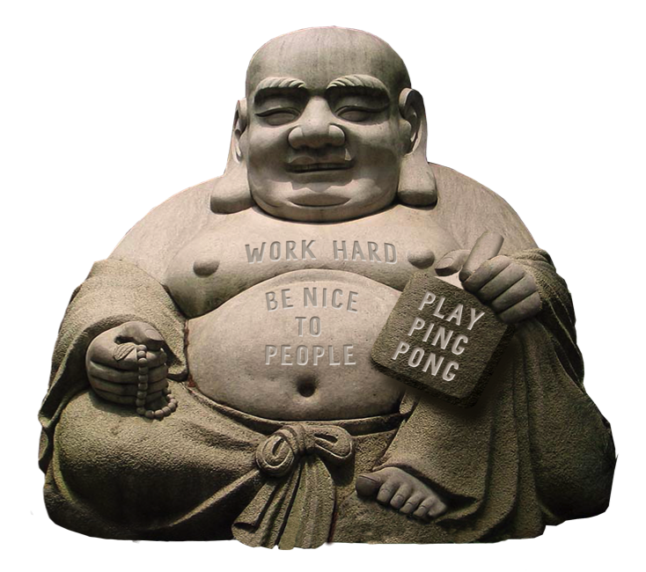
THANK YOU

