Slide 1
New demands on marketing in the digital age

Slide 2

80% of brands believe they deliver great consumer experiences (Cibo, 2014)
Only 8% of consumers agree

Slide 3
The majority of people worldwide wouldn't care if 73% of brands disappeared tomorrow (Havas Meaningful Brands)

Slide 4
Project Reconnect
To develop a better understanding of what people want and expect from brands so WFA can help marketers better align marketing strategies and practices with people’s changing expectations and sensitivities.
@WFAReconnect | #ProjectReconnect

Slide 5


WHAT WILL DEFINE BEST-PRACTICE MARKETING IN THE FUTURE?

Slide 6

WE ASKED INDUSTRY INFLUENCERS AND THEIR NETWORKS VIA SOCIAL MEDIA

Slide 7
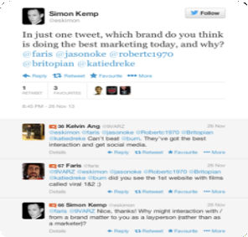
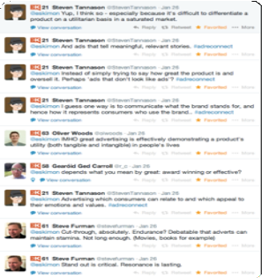
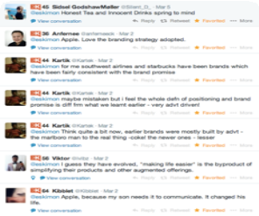
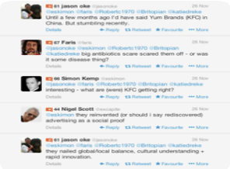
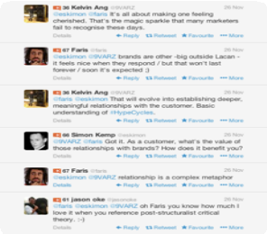
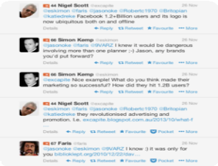
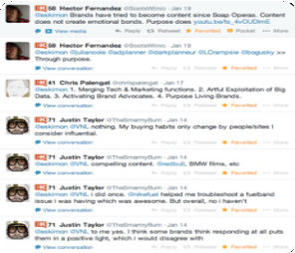
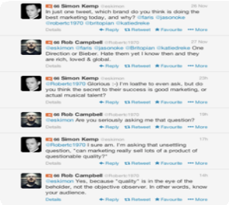
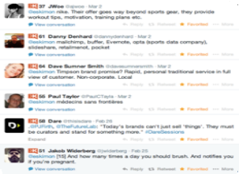
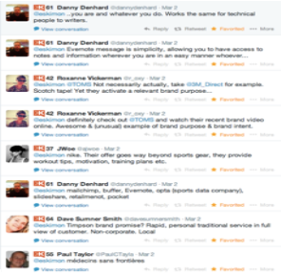
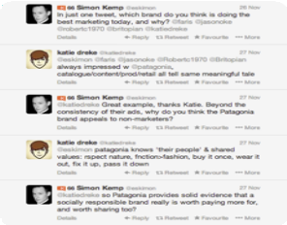
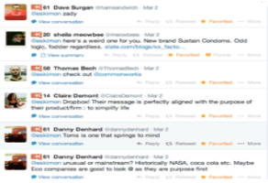
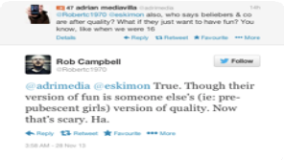

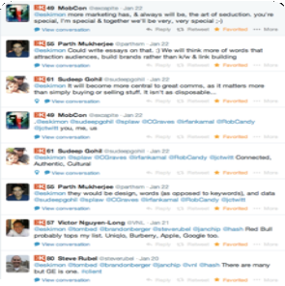
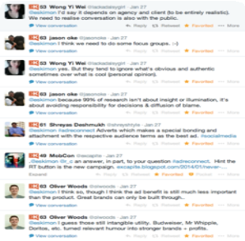
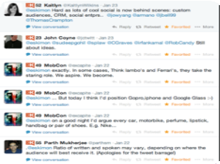
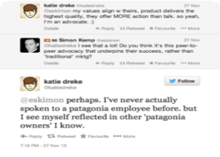
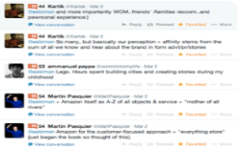

Slide 8



RECURRING THEMES: THE 3 NEW Ps
PURPOSE
DON’T JUST MAKE BETTER THINGS; MAKE THINGS BETTER
PRINCIPLES
USE YOUR BRAND’S VALUES TO DELIVER MEANINGFUL VALUE
PARTICIPATION
DON’T INTERRUPT PEOPLE; ENGAGE AND INVOLVE THEM

Slide 9
PURPOSE

Slide 10
#1
A PURPOSE
IS MORE COMPELLING THAN
A PRODUCT

Slide 11

PRODUCT DIFFERENTIATION ALONE NO
LONGER OFFERS SUSTAINABLE DVANTAGE

Slide 12


TO SUCCEED IN THE FUTURE, BRANDS NEED TO ENGAGE PEOPLE’S HEADS AND HEARTS

Slide 13
MAKE THINGS BETTER
VS
MAKE BETTER THINGS

Slide 14



SOME BRANDS WITH A HIGHER PURPOSE
THE BODY SHOP
AGAINST ANIMAL TESTING
PATAGONIA
ENVIRONMENTAL AND SOCIETAL RESPONSIBILITY
TOMS
ONE-FOR-ONE

Slide 15

WHEN MANAGED EFFECTIVELY, A BRAND’S PURPOSE CAN TRANSCEND CATEGORIES

Slide 16
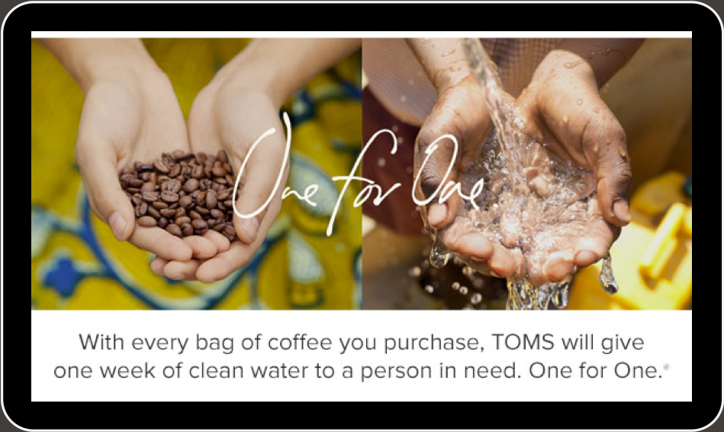
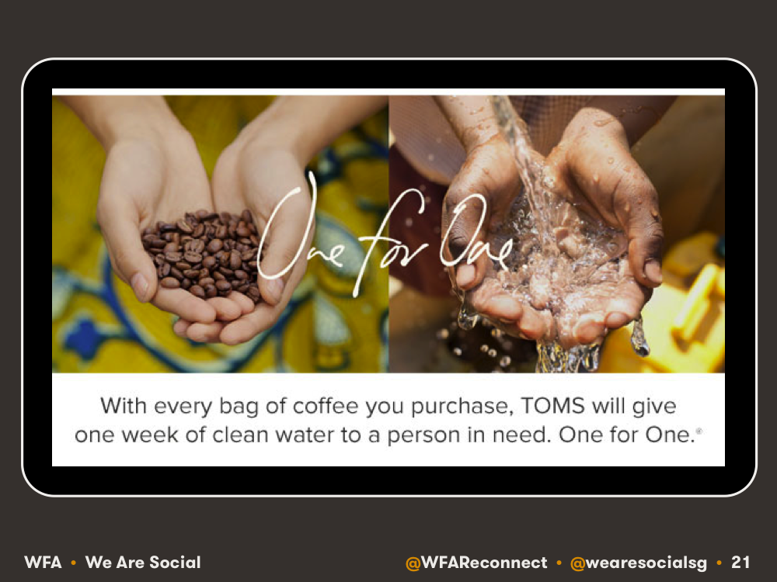

Slide 17
Notes:
https://www.youtube.com/watch?v=X1mQ0-AtGJw
1:42

Slide 18

HOWEVER, A BRAND’S PURPOSE DOESN’T NEED TO BE ABOUT SAVING THE WORLD

Slide 19

RED BULL: REDEFINING THE LIMITS OF PERCEIVED HUMAN POTENTIAL

Slide 20
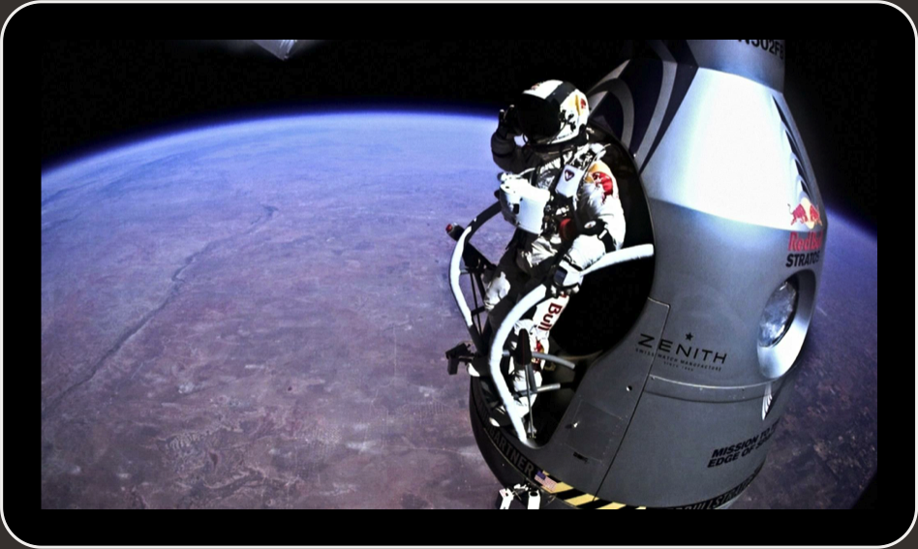
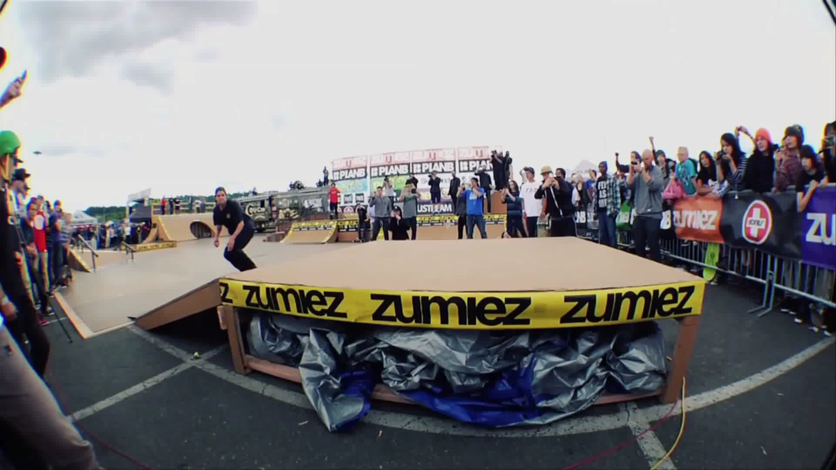
Notes:
https://www.youtube.com/watch?v=Kzj4Gw6XCUc
00:32

Slide 21

GOLDIEBLOX: INSPIRING GIRLS TO EXPLORE BROADER HORIZONS

Slide 22
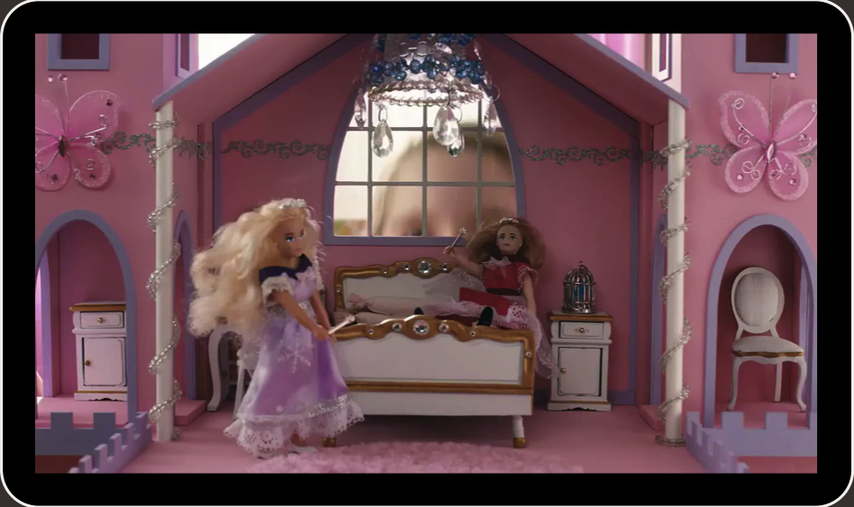
Notes:
https://www.youtube.com/watch?v=VepAmqQnUBg

Slide 23

PRINCIPLES

Slide 24
#2
BRAND VALUES
ARE MORE COMPELLING THAN
PRODUCT VALUE

Slide 25


SOME VALUES-BASED BRANDS
INNOCENT DRINKS
BEN & JERRY’S

Slide 26

WHEN THE EMPEROR IS NAKED, IT DOESN’T TAKE LONG FOR THE NEWS TO SPREAD

Slide 27


Slide 28

HOWEVER, IT SEEMS NO-ONE EXPECTS BRANDS TO BE PERFECT ALL THE TIME

Slide 29

THE WAY A BRAND DEALS WITH ITS ISSUES IS MORE IMPORTANT THAN THE ACTUAL ISSUES

Slide 30

WHAT THE BRAND DOES IS FAR MORE IMPORTANT THAN WHAT IT SAYS

Slide 31

THAT MAY SEEM OBVIOUS, BUT TOO MANY BRANDS PRIORITISE CLAIMS OVER ACTION

Slide 32

?
SO HOW DO PEOPLE EXPECT BRANDS TO ACT?

Slide 33

THERE ARE MANY SIMILARITIES TO THE TRAITS THAT DEFINE POPULAR PEOPLE

Slide 34

HUMOUR: WE’RE HAPPY TO GIVE OUR ATTENTION TO BRANDS THAT ENTERTAIN US

Slide 35
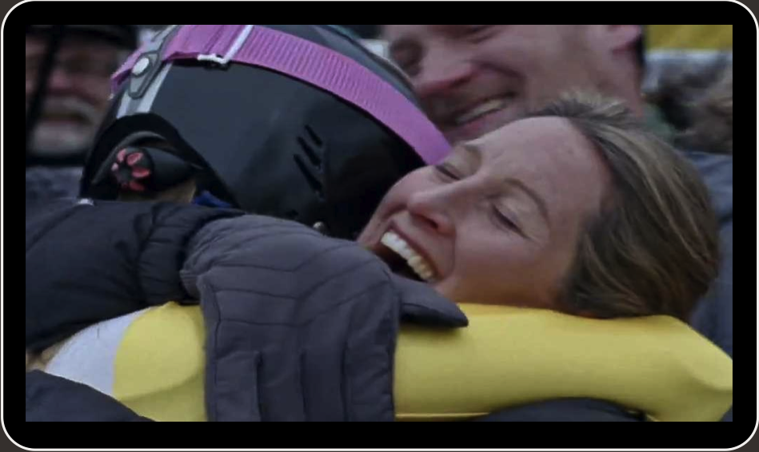

Slide 36

GENEROSITY: THE WILLINGNESS TO GIVE BEFORE ASKING SOMETHING IN RETURN

Slide 37

EMPATHY: THE ABILITY TO CONNECT WITH REAL PEOPLE AND ‘BEHAVE LIKE ONE OF US’

Slide 38


Slide 39
Notes:
https://www.youtube.com/watch?v=LpK8BbwZ0ok

Slide 40
PARTICIPATION

Slide 41
#3
PARTICIPATION
IS MORE EFFECTIVE THAN
PROMOTION

Slide 42

TOO MUCH OF TODAY’S MARKETING IS ABOUT GRABBING PEOPLE’S ATTENTION

Slide 43




VS
BUT WE’RE CONFUSING ATTENTION WITH ATTRACTION – “I’M AWARE” vs “I CARE”

Slide 44
“
The brand’s role is no longer just to broadcast, but to listen, participate and inspire actions.
Juliet Chen • @julietchen

Slide 45

WE NEED TO THINK OF PEOPLE AS PART OF OUR BRANDS, NOT AS OUR ‘CONSUMERS’

Slide 46

EXAMPLES OF INCLUSIVE MARKETING
STARBUCKS
MY STARBUCKS IDEA

Slide 47

PEOPLE ARE MORE ENGAGED WHEN THEY’RE ACTIVELY INVOLVED IN CREATION

Slide 48
THE 3 Ps OF CONNECTED MARKETING
PURPOSE
DON’T JUST MAKE BETTER THINGS; MAKE THINGS BETTER
PRINCIPLES
USE YOUR BRAND’S VALUES TO DELIVER MEANINGFUL VALUE
PARTICIPATION
DON’T INTERRUPT PEOPLE; ENGAGE AND INVOLVE THEM

Slide 49

NONE OF THIS SHOULD SEEM LIKE ROCKET SCIENCE

Slide 50

SO WHY AREN’T WE ALL DOING IT ALREADY?

Slide 51


JOIN THE CONVERSATION!
#PROJECTRECONNECT
@WFARECONNECT
To join our mailing list, please email Will:
w.gilroy@wfanet.org

